Slide 1

Introduction to Artificial Intelligence
Rectangle Packing

Slide 2
Rectangle Packing
The problem of filling as much space as possible in a given enclosing rectangle, using given rectangles of fixed dimension.
Eg:
squares: 1x1, 2x2, 3x3...24x24
enclosing square: 70x70
The optimal solution is required
Squares are just a special case of the general Rectangle
Packing problem
...

Slide 3
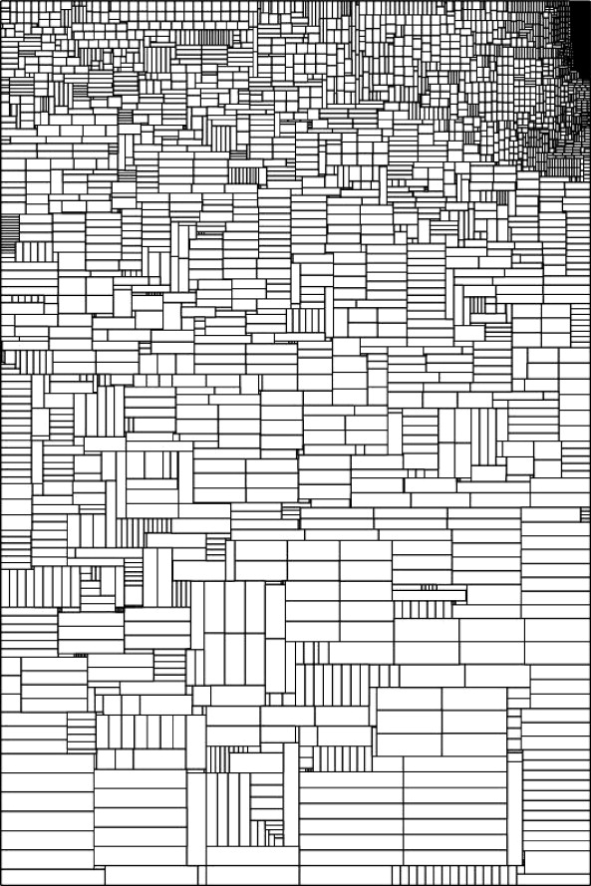
Applications:
VLSI circuit design
Stock cutting
Freight transportation
Graphical layout

Slide 4
The square packing problem
Squares: 1x1, 2x2, 3x3....24x24 (total area = 4900)
Enclosing square: 70x70 (total area = 4900)
cannot be solved so that all squares are packed, even though the total areas are the same.
The optimal solution wastes 49 units of space and omits the 7x7 square.
The solution is optimal because you cannot waste any less space.
The (exhaustive) proof of this result explored 20 billion nodes.

Slide 5
Complexity
Rectangle Packing is very hard.
How many positions are there for the next rectangle?
Discretise the grid
Rectangles can be placed
with their top-left corners
on any grid point
Always in the same orientation
(0,7)
(9,7)
(0,0)
(9,0)

Slide 6
Take the rectangles as the variables of the problem
And the grid points as the values that can be assigned to those variables
Then, for a 10x10 enclosing rectangle (100 values), and 5 rectangles to pack (5 variables), this gives us at most 100⁵ possible assignments (100⁵ = (10²)⁵ = 10¹⁰ = 10 billion).

Slide 7
Just adding one more grid point gives us 500 million new assignments.
(Use the new point: 5*100^4
Don’t use it: 100^5
Sum these: 100^5 + 5*100^4 = 10.5 Billion)
Adding one more rectangle gives us 990 billion new assignments.
(10 billion choices for 5 rectangles, times 100 choices for the 6th = 10 billion * 100 = 1 trillion)

Slide 8
Pruning the search space
Luckily most of the choices are invalid because of constraints. (Examples?)
Overlap constraint: we cannot place a new rectangle so that it overlaps with one already placed.
Boundary constraint: rectangles cannot overlap the enclosing boundary.
There is also a lot of symmetry in the problem, around the axes of the enclosing rectangle.
But as the problem grows the asymptotic complexity dominates.

Slide 9
What is the goal state?
Unlike other search problems seen so far, the goal is not a description of a single state, but of a set of states.
The goal states are those with the minimum wasted space.
Wasted space can be distributed in different ways round the grid.
How do you evaluate an intermediate state when you don’t know how much space will end up being wasted?

Slide 10
Total area: 100
Total area: 88

Slide 11
One possible packing:
Wasted space: 12

Slide 12
Another possible packing:
Wasted space: 18

Slide 13
Getting insights into the problem
Because you don’t want to waste space you are better off packing rectangles into corners first.
If you don’t pack big things early on, you probably never will.
This leads to a greedy strategy.

Slide 14
Greedy solution
We can do very well by using a greedy approach that places the rectangles in decreasing order of size, always as far left, then as high up, as possible.
Strategy: order the rectangles by decreasing area (break ties randomly); place them one by one till enclosing rectangle is filled.
No search!
Is this optimal?

Slide 15
Greedy Solution
Wasted space: 12
Optimal!

Slide 16
Greedy solution
Packed: 91
Wasted: 9
Unpacked: 6

Slide 17
A better solution
Packed: 93
Wasted: 7
Unpacked: 4
We can do even better than this – the optimal solution wastes only 5 cells and leaves only 2 cells unpacked. (spot it!)

Slide 18
How would we search?
Clearly uninformed search is hopeless because of the size of the search space.
A* search requires an admissible and highly informative heuristic.
Reminder: an admissible heuristic is always an under-estimate of the distance to the goal
0 is admissible but uninformative

Slide 19
Evaluating a state
How much space is wasted?
Definitely 5 cells are wasted.

Slide 20
A* functions
We can use h(s) = definitely wasted space,
We use g(s) = area packed so far
f(s) = g(s) + h(s) and we minimise f(s).
f(s) = g(s) + h(s)
= 30 + 5
= 35
f(s) = g(s) + h(s)
= 30 + 0
= 30

Slide 21
Is f(s) admissible?
Because it only counts space as wasted if it definitely already is, we know that f(s) will never say that a state is worse than it is.
So f(s) is admissible.
Is it informative?
This depends on
how well it
distinguishes
between states.
=

Slide 22
Problem
Why is the problem defined in terms of minimising wasted space, rather than in terms of maximising the number of rectangles to be packed?
Design an example to show that these criteria are not the same.
(ie: Devise an instance in which maximising the number of rectangles packed does not give a solution that minimises wasted space)

Slide 23
Answer
Suppose you have an instance consisting of 10 1x1 squares and 1 10x10 square, and an enclosing square that is 10x10.
To minimise wasted space you would pack the 10x10 and have 0 wasted cells.
To maximise the number of rectangles packed you would pack the 10 1x1 squares, and have 90 wasted cells.

